Slide 1
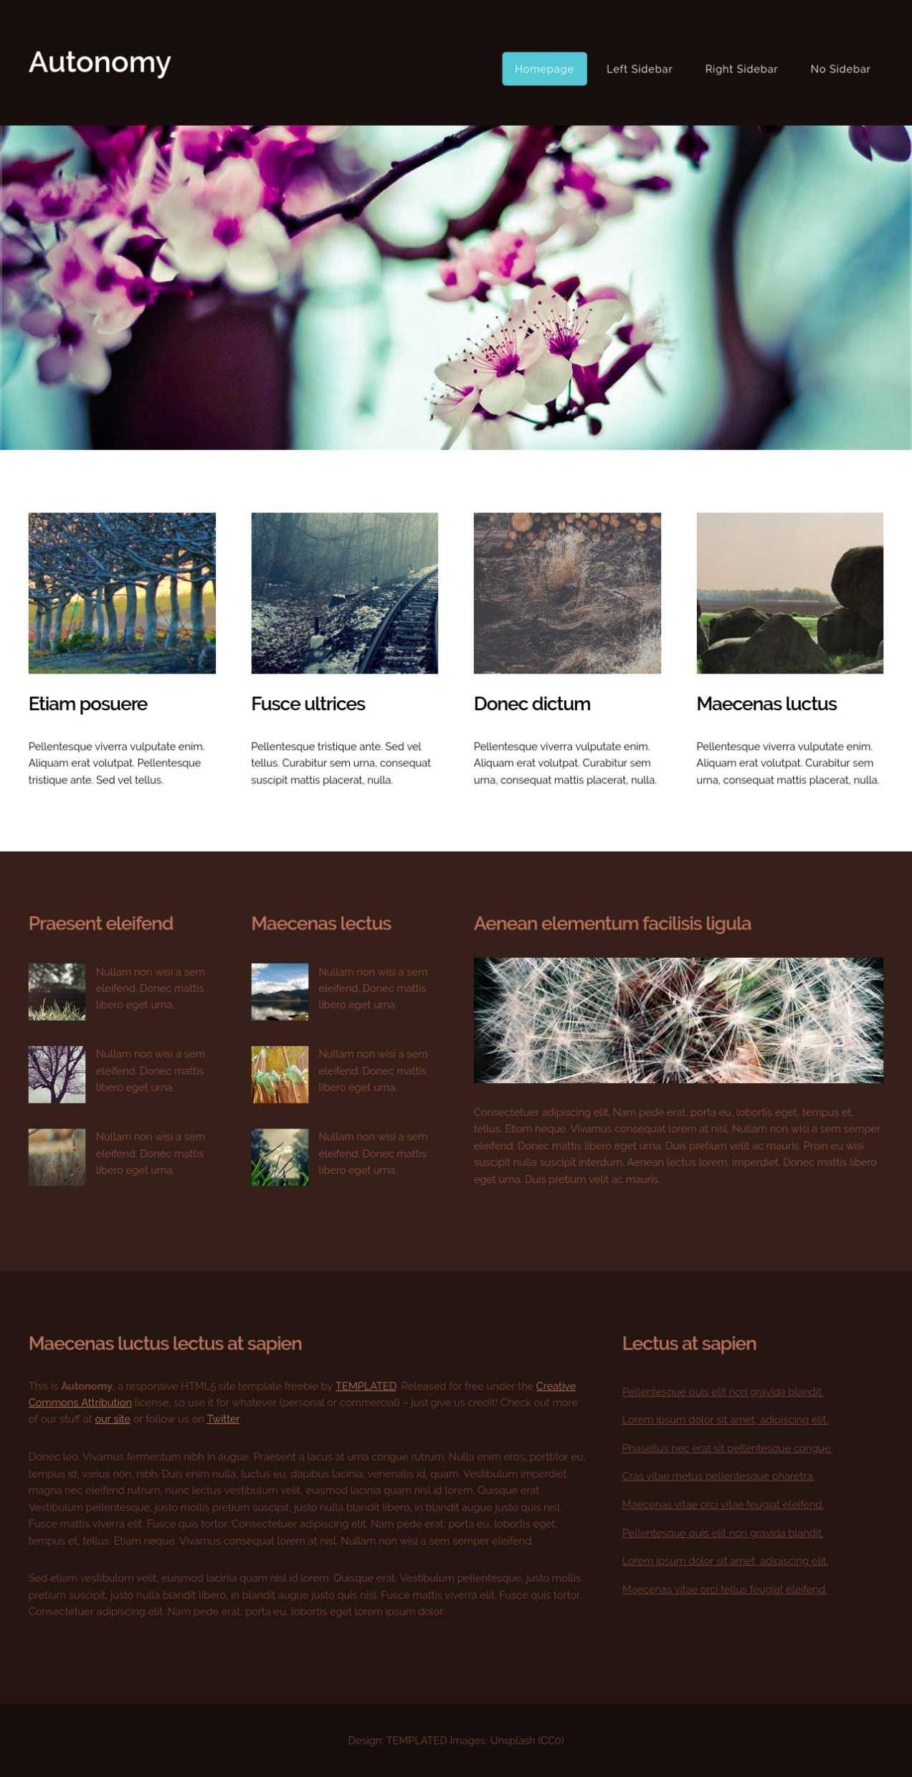
h1
h2, nav, a
header
img
img
img
img
img
main
h2, p
h2, p
h2, p
h2, p
section
h2, img, p
h2, img, p
h2, img, p
article
h2, p, a
h2, p, a, ul
div
h3
footer

